Slide 1

ADD FLAVORS BAKESHOP INVENTORY AND MONITORING OF PRODUCT AND SALES
October 10, 2017

Slide 2
The Add Flavors Bakeshop just started this year March 2017. The bakeshop’s goal is to create different kinds of delicious breads. The owner of the bakeshop was influenced by her friends that make her decide to start a business which is bakery. It is also her passion to bake breads. Their customer is treated with friendly and attentive service. They believe that the best quality of product doesn't always come in high-tag price.

Slide 3
JasperServer provides a web based interface to manage, schedule, and run the reports; a repository to store all the report resources like images, fonts, data sources and much more; a security service to decide who can execute which report; and a web services API to execute the reports from external applications (so you can generate reports from any kind of environment, like PHP or .NET).

Slide 4
TEAM ROLES
Joseph Rey Vincent Autentico
-incharge of the documentation.
Gay Marist Estimo
-front end
Mary Grace Guilon
-back end

Slide 5
Project Development Platform
The primary software utilized in the development of our system are the following:
Netbeans/JFrame (For our front-end)
SQLite (for our back-end)
Netbeans (For the development environment)

Slide 6
Project Scope
Our project/system has the following features:
It has the ability to monitor sales and stocks as requested by the client/owner of the bakeshop
Create an entry if the owner desires to add new products
Read a data entry if required for monitoring purposes
Update a data entry if needed to change price, description, etc.. if the owner desires to do so
Delete data entry in the event of multiple entry

Slide 7
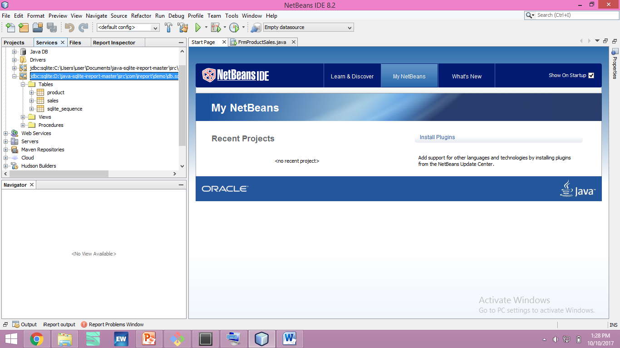
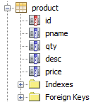


Database Schema

Slide 8
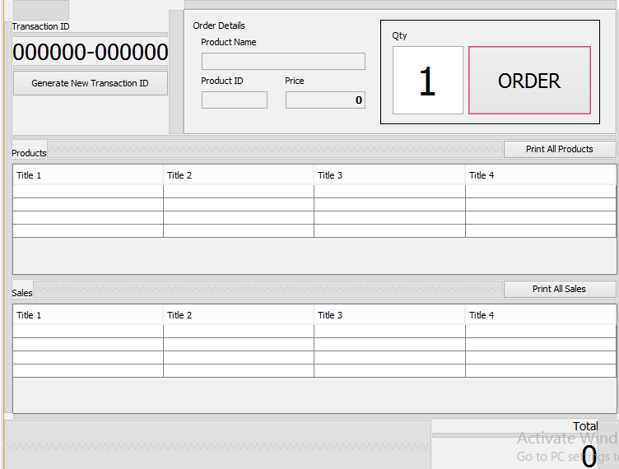
Wireframe

Slide 9
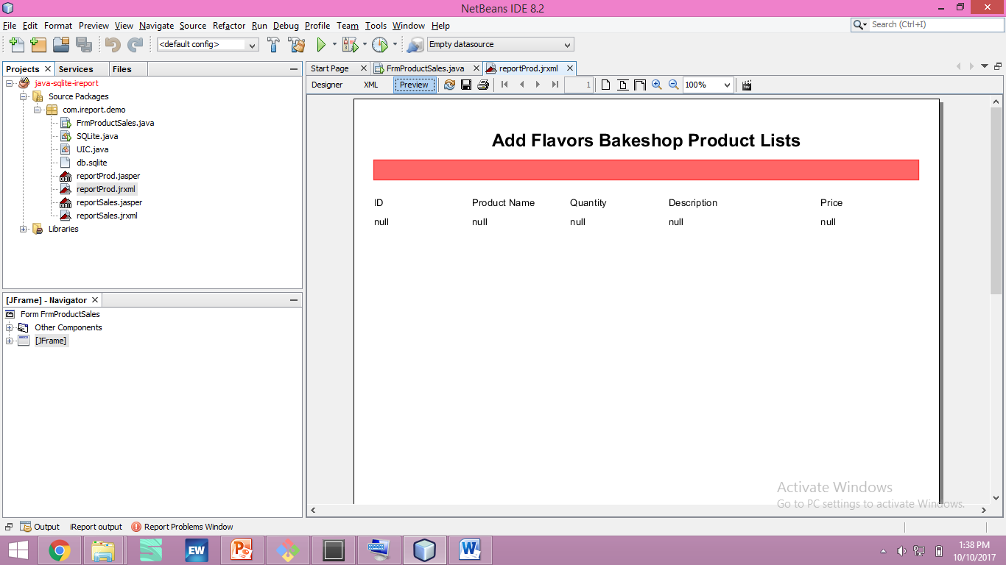

Slide 10
